Slide 1
Life Expectancy from
2000 to 2015
Clara Richardson, Danielle Dubash,
Christian Suarez, Jennifer Melendez

Slide 2
Research Questions:
Question 1:
Question 2:
What are the key determinants affecting life expectancy?
Developed VS. Undeveloped Regions
Alcohol consumption VS. Life Expectancy
BMI VS. Life Expectancy
GDP per Capita VS. Life Expectancy
Years of Education Vs. Life Expectancy
How do these results change over time?
Life Expectancy from 2000 to 2015
GDP Per Capita from 2000 to 2015
Years of Education from 2000 to 2015

Slide 3
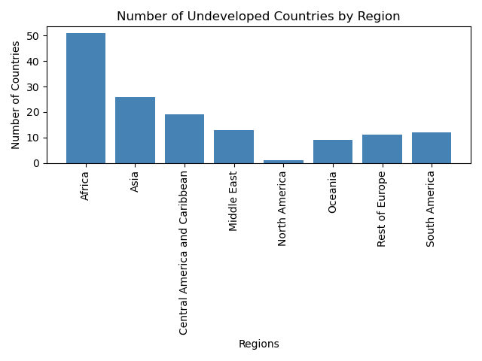
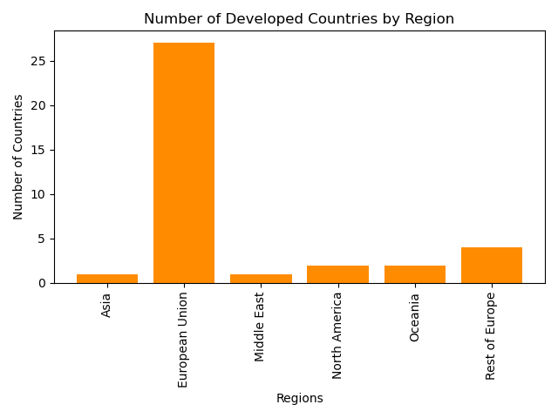
Number of Undeveloped/Developed Countries by Region
To examine whether developed or undeveloped regions were a key determinant in life expectancy, we divided the countries. The dataset included an Economy status column indicating developed or developing.

Slide 4
Summary Statistics
 | Alcohol Consumption | GDP per capita | Population (Millions) | Years of Schooling | Life Expectancy
Count | 2864 | 2864 | 2864 | 2864 | 2864
Mean | 4.82 | 11540.92 | 36.68 | 7.63 | 68.86
STD | 3.98 | 16934.79 | 136.49 | 3.17 | 9.41
Min | 0 | 148 | 0.08 | 1.1 | 39.4
25% | 1.2 | 1415.75 | 2.1 | 5.1 | 62.7
50% | 4.02 | 4217 | 7.85 | 7.8 | 71.4
75% | 7.78 | 12557 | 23.69 | 10.3 | 75.4
Max | 17.87 | 112418 | 1379.86 | 14.1 | 83.8

Slide 5
Life Expectancy Tests
* Tests performed for full dataset, all others focus on 2015 data
Comparison | Test | P-Value
Developed vs. Developing Nations | T-Test | 4.91e-31
GDP Ranges* | ANOVA | 1.05e-214
Regions <75yrs | ANOVA | 9.43e-14
Regions >75yrs | ANOVA | 0.000313
Africa / European Union | T-Test | 4.17e-26
Africa / Oceania | T-Test | 0.0005256
European Union / North America | T-Test | 0.6715245
Observed vs. Expected Life Expectancy by Region | Chi-Square | 0.9491862

Slide 6
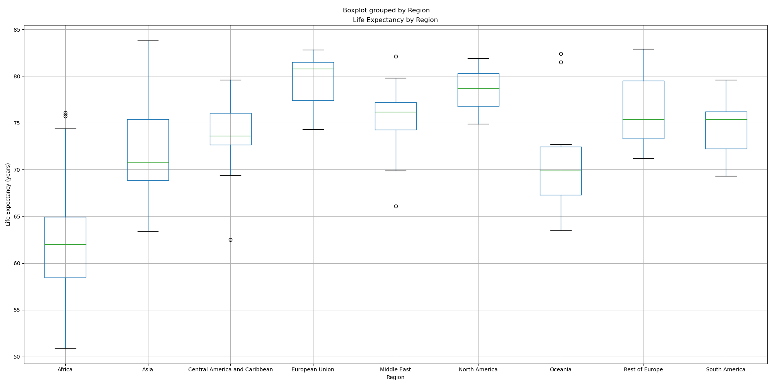
Boxplot for Life Expectancy by Region
Notes:
!!! update with new file (need title to say 2015)

Slide 7
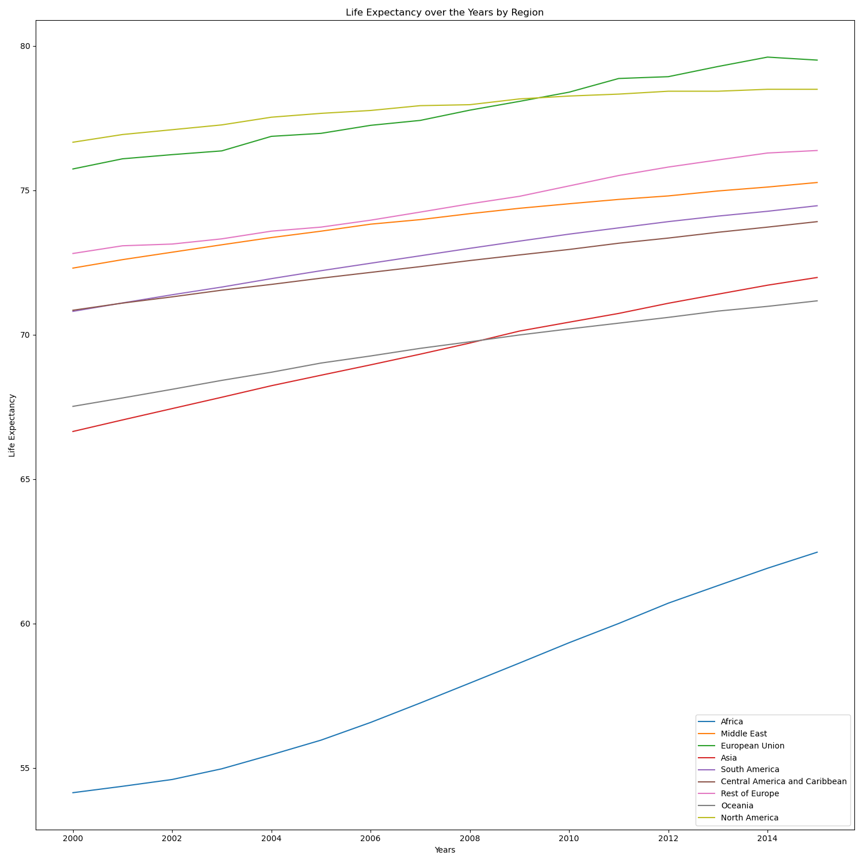
Life Expectancy Over the Years by Region
After analyzing the dataset, we were able to single out each region and determine if life expectancy had increased through the span of 15 years. According to our line graph,life expectancy has increased for every region. However, which determinants are impacting growth?

Slide 8
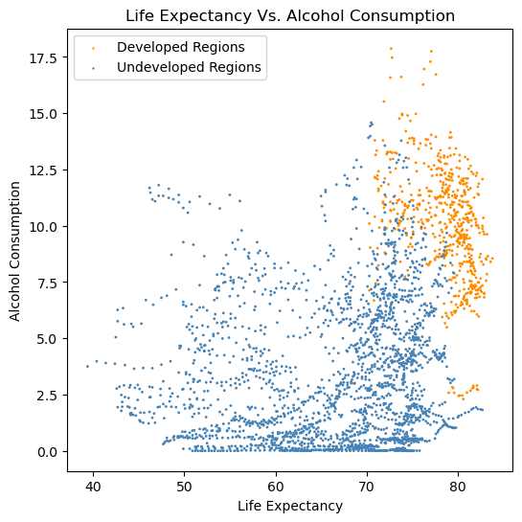
Life Expectancy Vs. Alcohol Consumption
The data provided a range of alcohol consumption for each country. The scatter plot indicates that developed regions have higher alcohol consumption levels compared to undeveloped regions. However, alcohol consumption may not be a key determinant of life expectancy. Rather, is developed or undeveloped a key determinant?

Slide 9
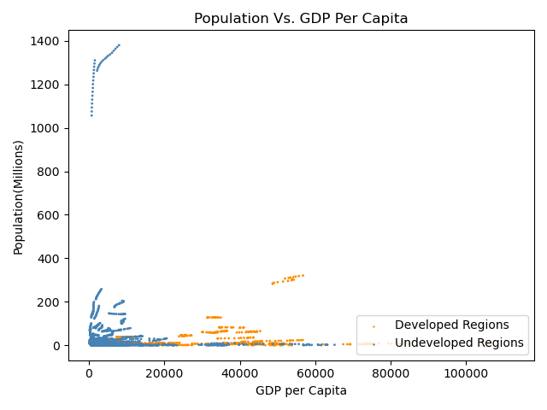
Population Vs. GDP per Capita
A variable we wanted to explore was population versus GDP per capita. Our findings indicate that population does not determine higher GDP per capita.

Slide 10
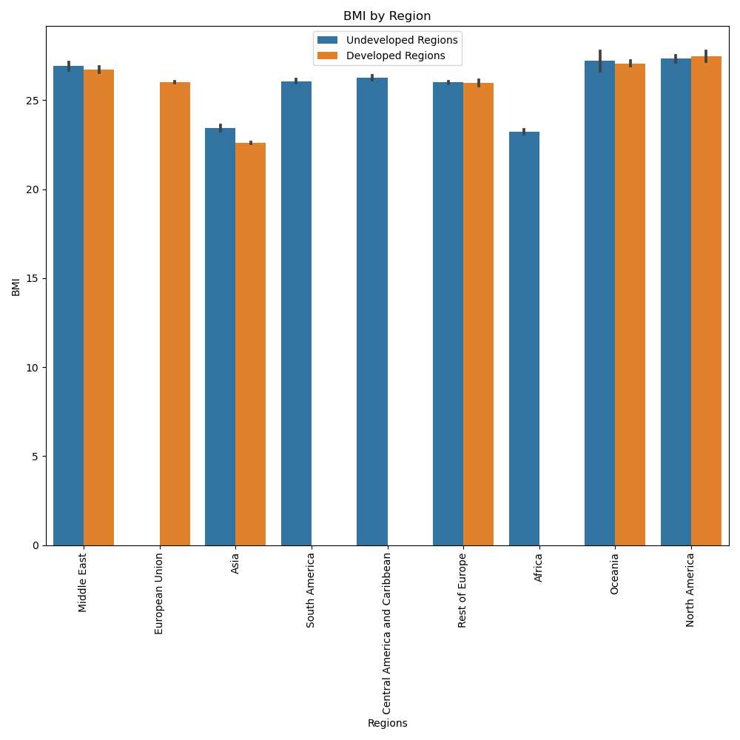
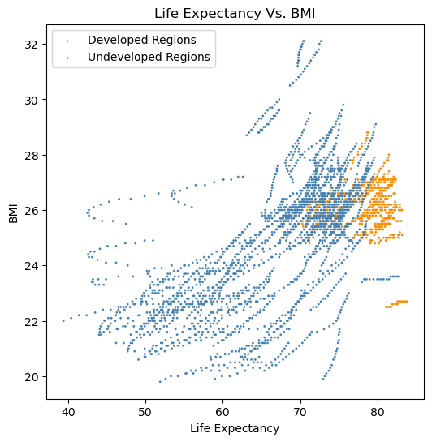
Life Expectancy Vs. Body Mass Index
The bar graph above represents regions and their body mass index percentage.
The scatter plot above represents body mass index percentage compared to life expectancy .

Slide 11
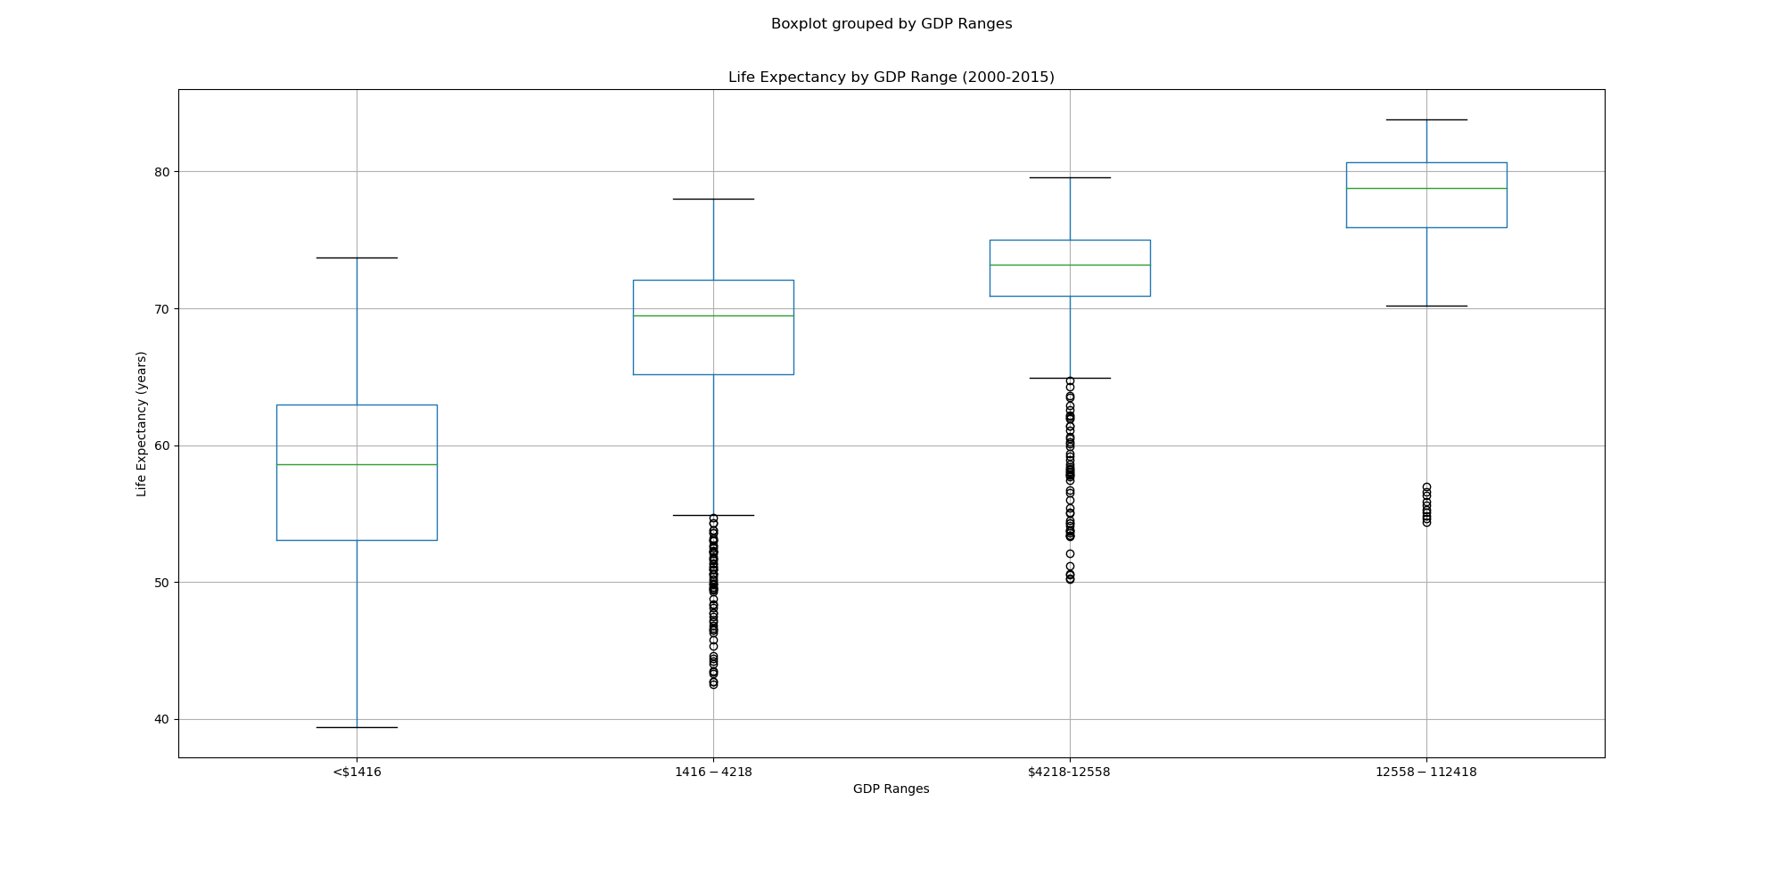
Boxplot grouped by GDP Ranges
ANOVA p-value=1.045725475514985e-214

Slide 12
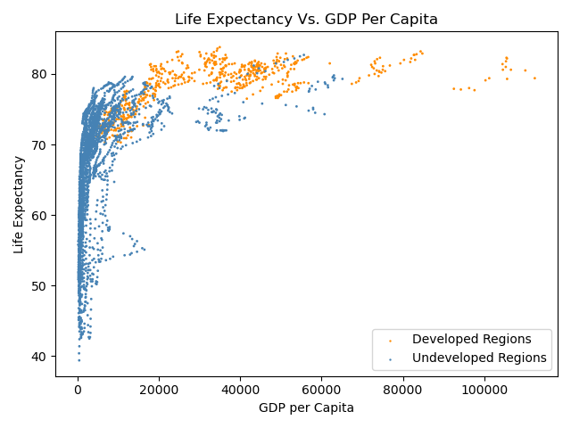
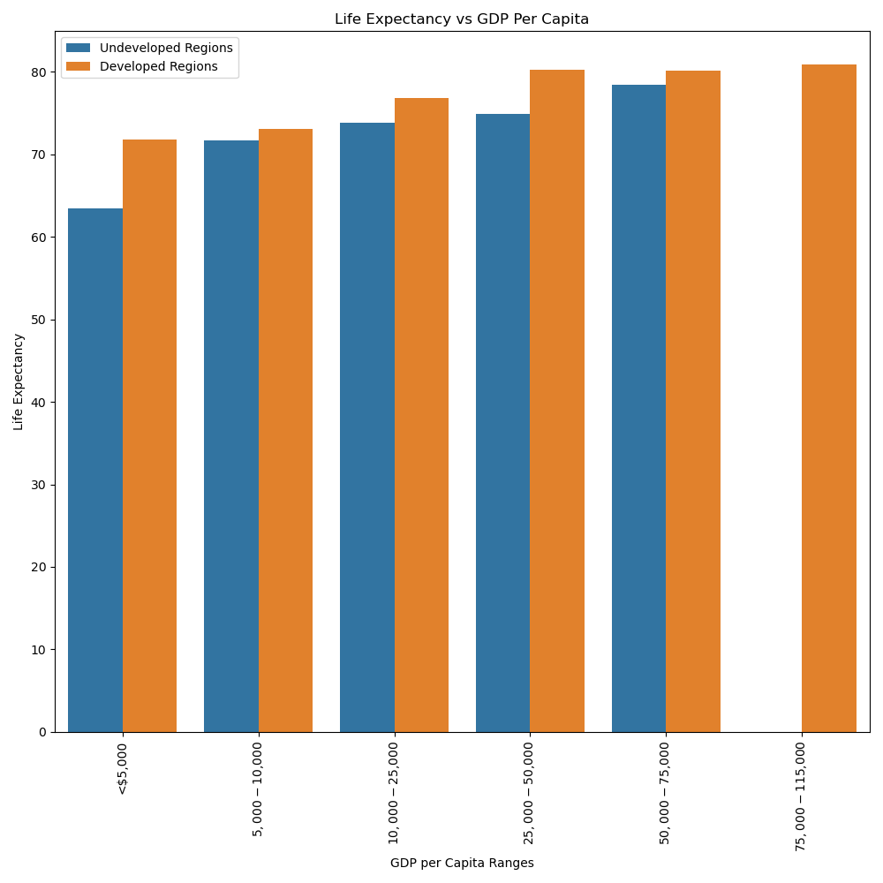
Life Expectancy Vs. GDP Per Capita
The scatter plot above describes the life expectancy compared to a country’s GDP per capita.
The bar chart above describes the life expectancy compared to a range of GDP per capita.

Slide 13
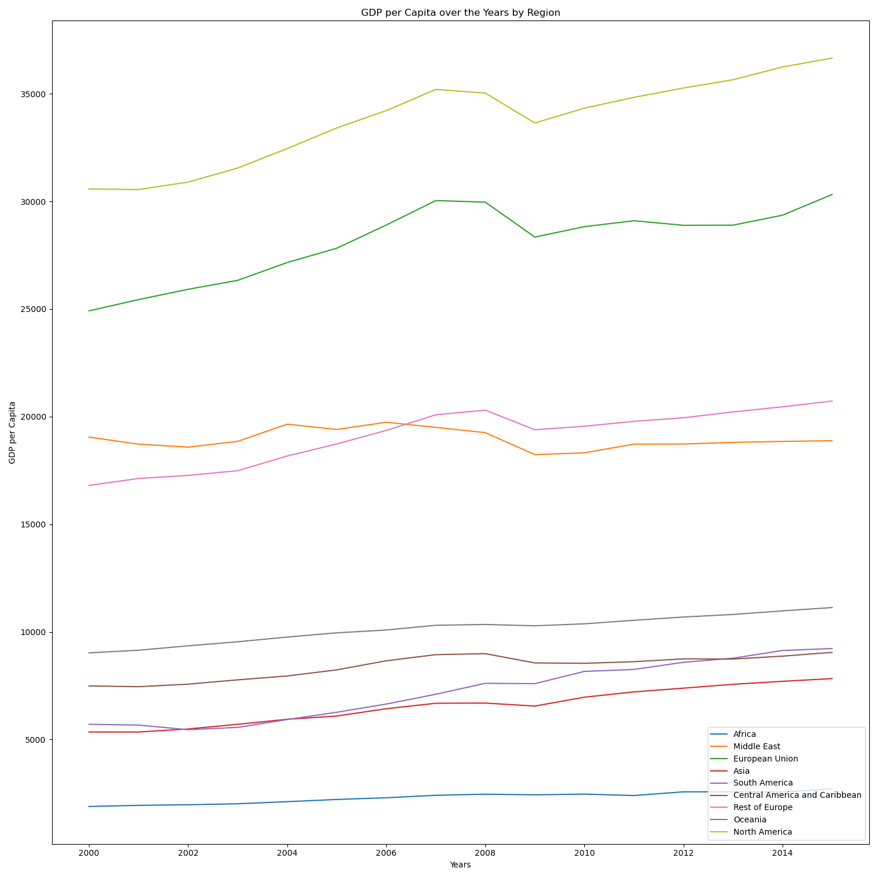
GDP per Capita Over the Years by Region
After analyzing life expectancy and GDP per capita, we decided to compare GDP over the years by region. As seen in the line graph, some regions had very little growth. However, regions such as Africa had an exponential amount of growth throughout the years. This led us to believe education might be a key determinant.

Slide 14
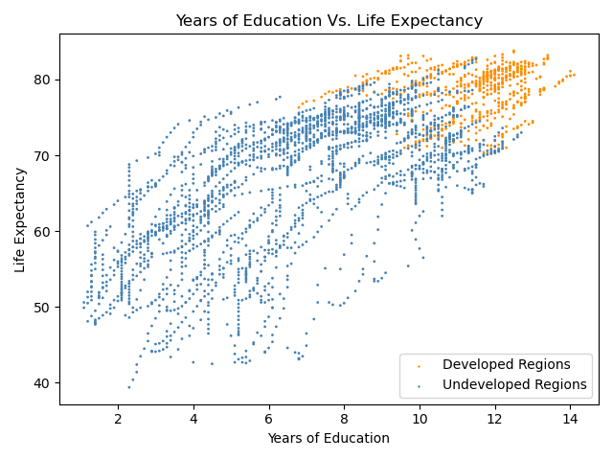
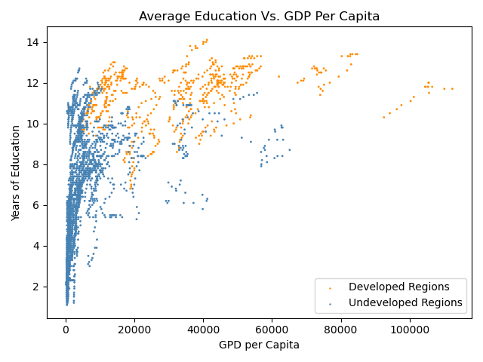
Life Expectancy Vs.Years of Education
The scatter plot above describes the life expectancy compared to a country’s education level.
The scatter plot above describes the average education level compared to the GDP per capita.

Slide 15
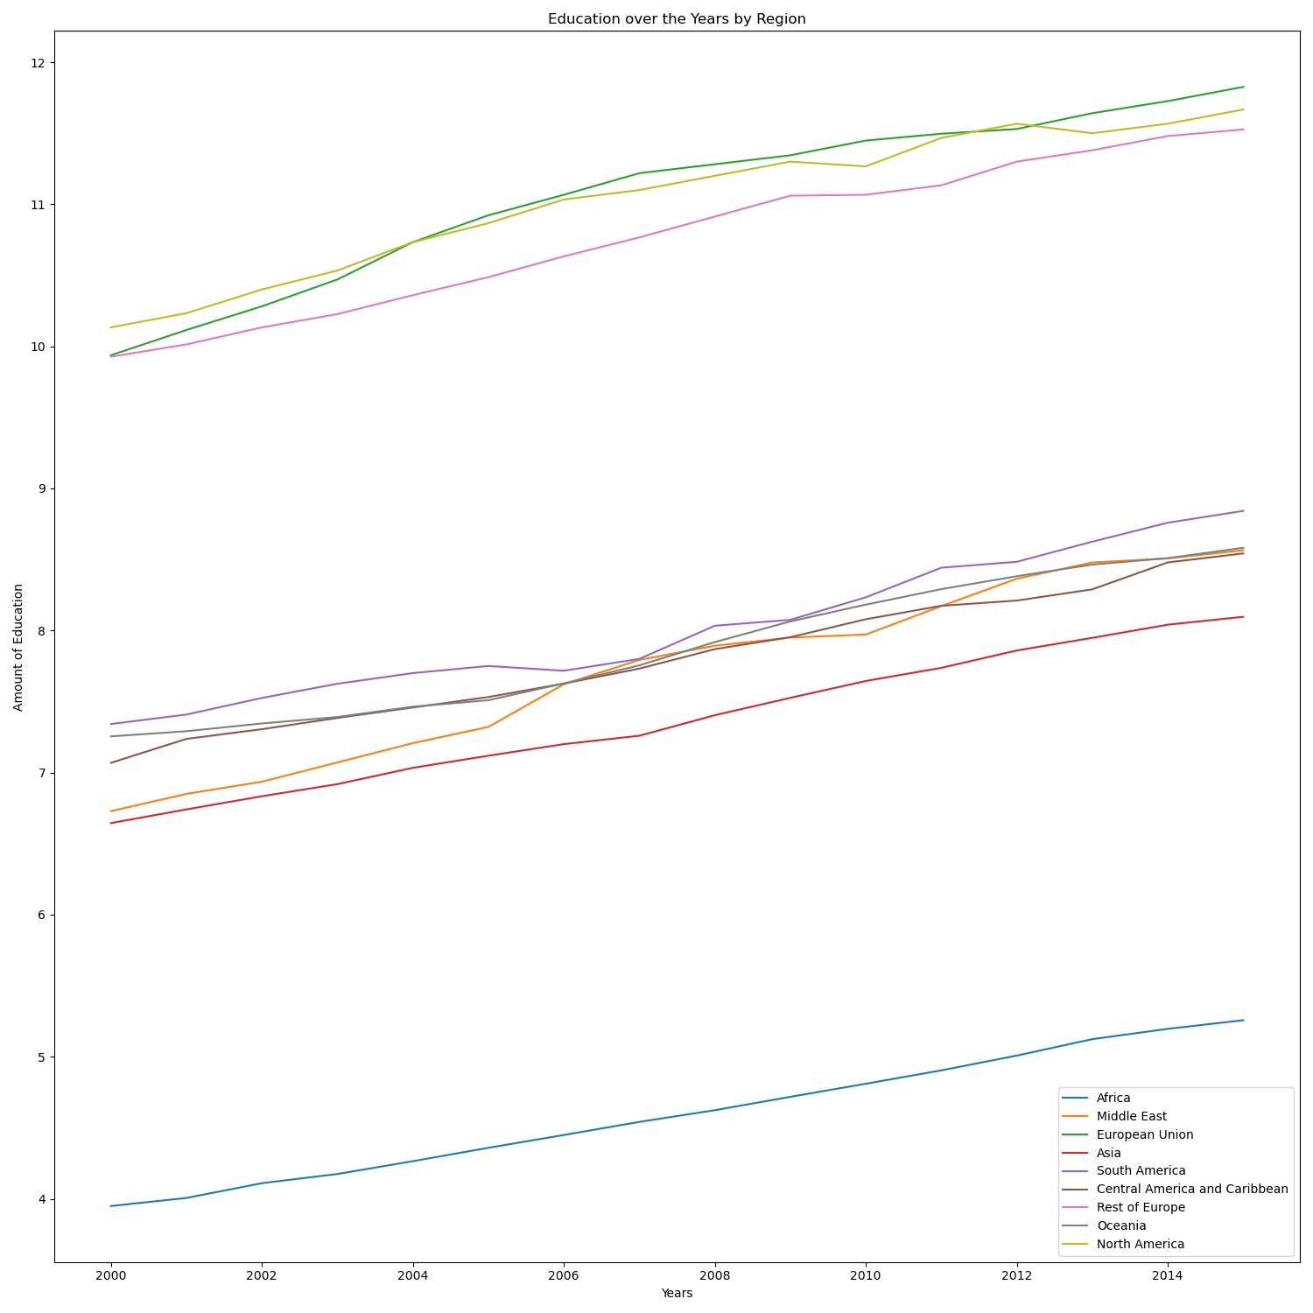
Education Over the Years by Region
We decided to narrow down each region once again. The line graph represents education by region from 2000 to 2015. The visualization shows us that education has increased over time.

Slide 16
Research Questions:
Question 1:
Question 2:
What are the key determinants affecting life expectancy?
Developed VS. Undeveloped Regions
Alcohol consumption VS. Life Expectancy
BMI VS. Life Expectancy
GDP per Capita VS. Life Expectancy
Years of Education Vs. Life Expectancy
How do these results change over time?
Life Expectancy from 2000 to 2015
GDP Per Capita from 2000 to 2015
Years of Education from 2000 to 2015

